Slide 1


Slide 2

Project Title: FurnishARt
Hafiz Talha Nazir (CIIT/SP21-BCS-007/ATD)
Muhammad Umer (CIIT/SP21-BCS-016/ATD)
Muhammad Noman (CIIT/SP21-BCS-014/ATD)
Supervisor: Ma’am Bushra Mushtaq
Department of Computer Science
COMSATS University Islamabad, Abbottabad Campus

Slide 3
Agenda of the Presentation
Project Introduction
Project Scope
Functional Requirements
Non-Functional Requirements
Use Case Diagram
Main Use Case
Sequence Diagram
Class Diagram
ER Diagram
Activity Diagram
Details of 1st Iteration (30%)
Details of 2nd Iteration (60%)
Details of 3rd Iteration (100%)
Conclusion

Slide 4
Project Introduction
Welcome to FurnishARt, an innovative AR-based Furniture Store Web Application designed to transform your online shopping experience.
The application goal is to enhance the online shopping experience by allowing customers to visualize products in their real-world environment before making a purchase.
The Proposed FurnishARt will include:
AR technology for furniture retail.
Interactive 3D models on our website.
Augmenting virtual products with real-world environments.
Immersive shopping experiences with AR.

Slide 5
Project Scope
FurnishARt will :
Be a single-seller furniture store.
Integrate AR for viewing 3D furniture models on our AR app.
Enable placing furniture in your space using your smartphone camera.
Allow users to interact with 3D models for a better shopping experience.
Sole focus on furniture products.

Slide 6
Functional Requirements
Customer Functional Requirements:
View Furniture
View AR Preview of Furniture
View 3D Model
Search by Filters
View Listing Details
View Similar Furniture
Add to Cart
Update Cart
Delete from Cart
View Cart
Proceed to Checkout
Enter Payment Information

Slide 7
Select Shipping Method
Place Order
View Orders
View Order Status
View Order History
Write Review
View Customer Reviews
Augment Multiple Furniture Items from List
Login
Forget Details
Logout

Slide 8
Admin Functional Requirements:
Add Furniture Listings
Update Furniture Listings
Delete Furniture Listings
View Furniture Listings on Admin Panel
Add 3D Models
Update 3D Models
Delete 3D Models
Generate Inventory Reports
Update Order Status
View Sales & Stock Dashboard
Manage Stocks

Slide 9
Non-Functional Requirements
Usability
User-Friendly Interface
Clear Instructions
Intuitiveness
Accessibility
Error Handling
Performance
Fast Loading and Execution
Scalability
Large Data Handling
Concurrent Users
Transaction Processing

Slide 10
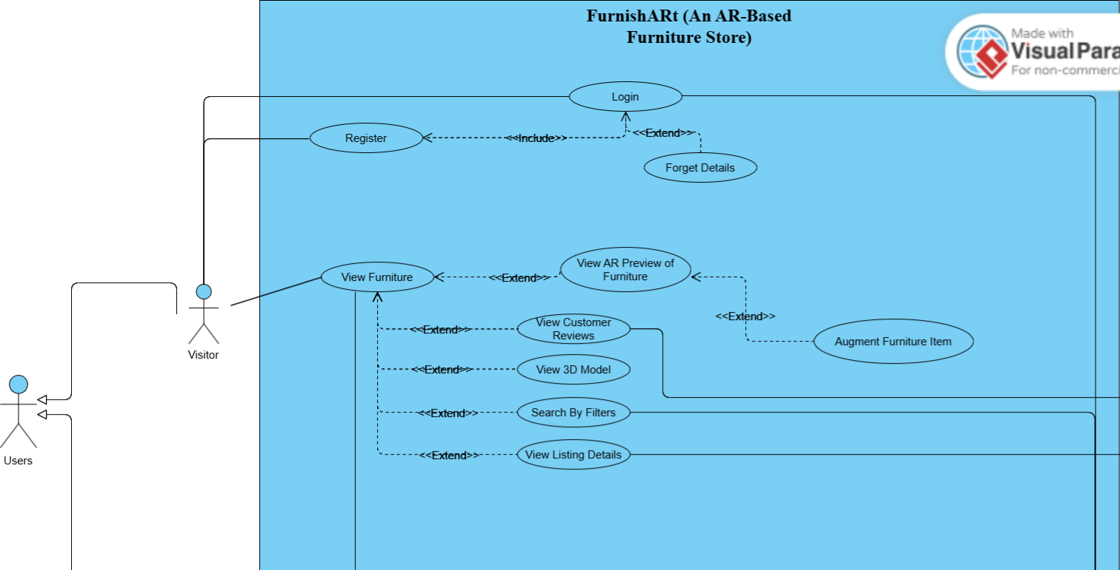
Use Case Diagram (Part 1)

Slide 11
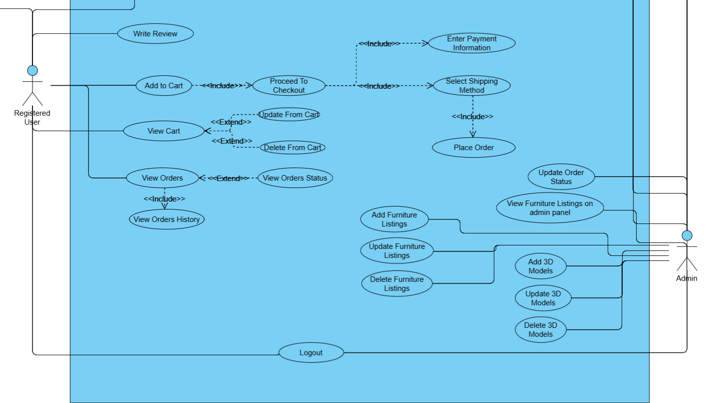
Use Case Diagram (Part 2)

Slide 12
Use Case | Main Use Case
Use Case Name: | Augment Multiple Furniture Items from List
Actors: | Registered User, Visitor
Description: | Enables users to visualize multiple furniture items simultaneously within their physical space.
Trigger: | User selects multiple furniture items to view in AR mode.
Preconditions: | User has initiated AR preview mode and has a compatible mobile device with a camera.
Postconditions: | User can see multiple virtual furniture items in their physical environment.
Normal Flow: | User navigates to the furniture listing. User selects multiple items for AR preview. System accesses the mobile device's camera. System shows similar category furniture items list in AR preview mode. System overlays the 3D models of the selected furniture items onto the live camera feed.
Alternative Flows: | If the device is not compatible, the system displays an appropriate message.
Exceptions: | AR functionality fails due to software or hardware issues.
Business Rules | Multiple items must be displayed accurately and maintain spatial relationships.
Assumptions: | Users will use this feature to visualize how multiple pieces of furniture work together in their space.

Slide 13
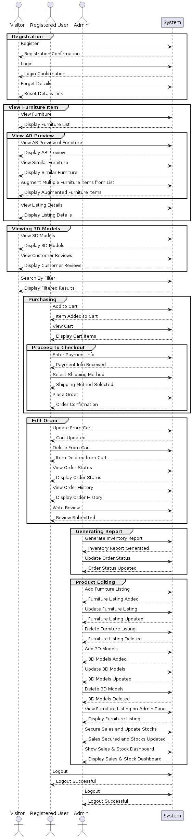
Sequence Diagram

Slide 14
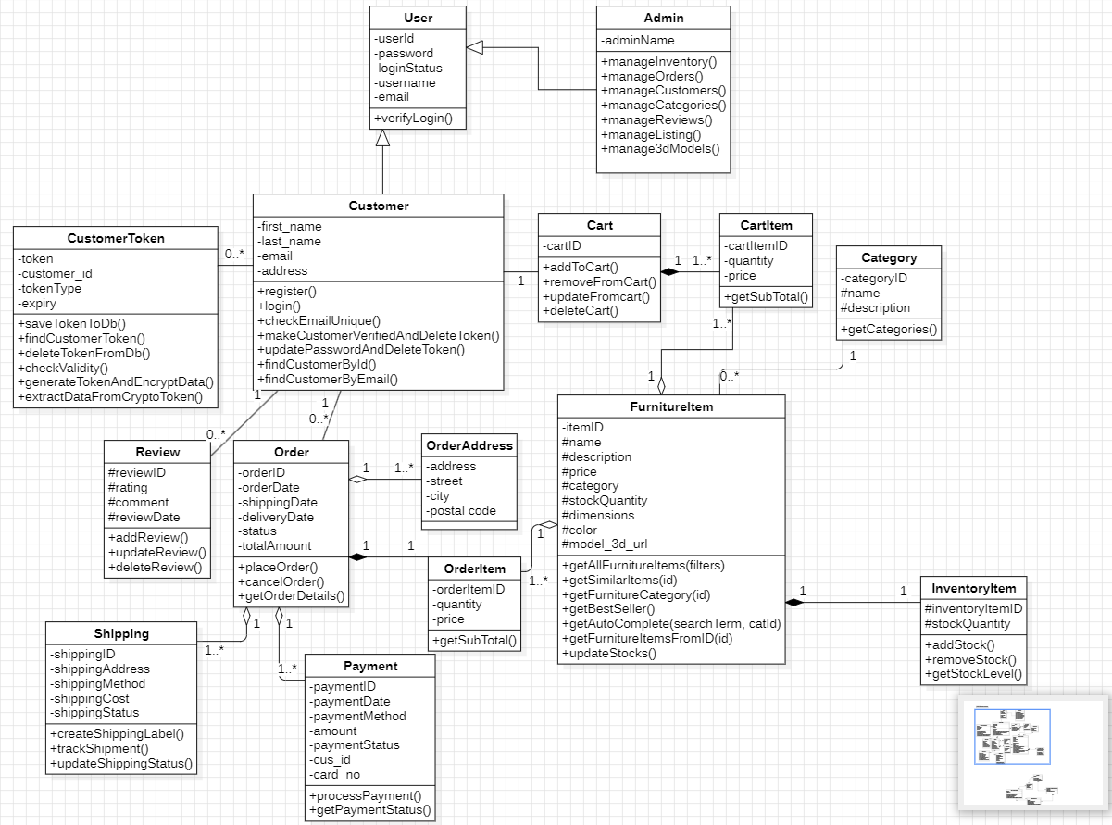
Website Class Diagram

Slide 15
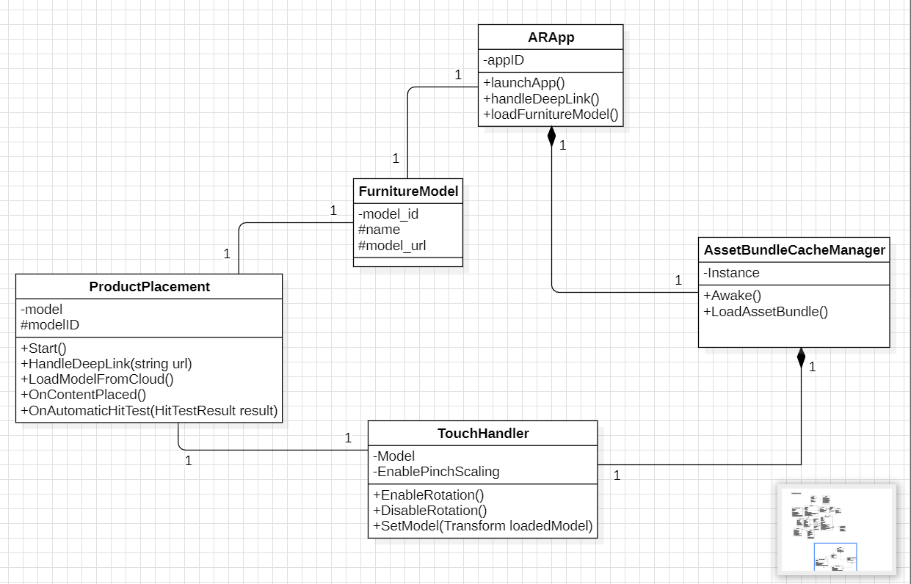
AR Class Diagram

Slide 16
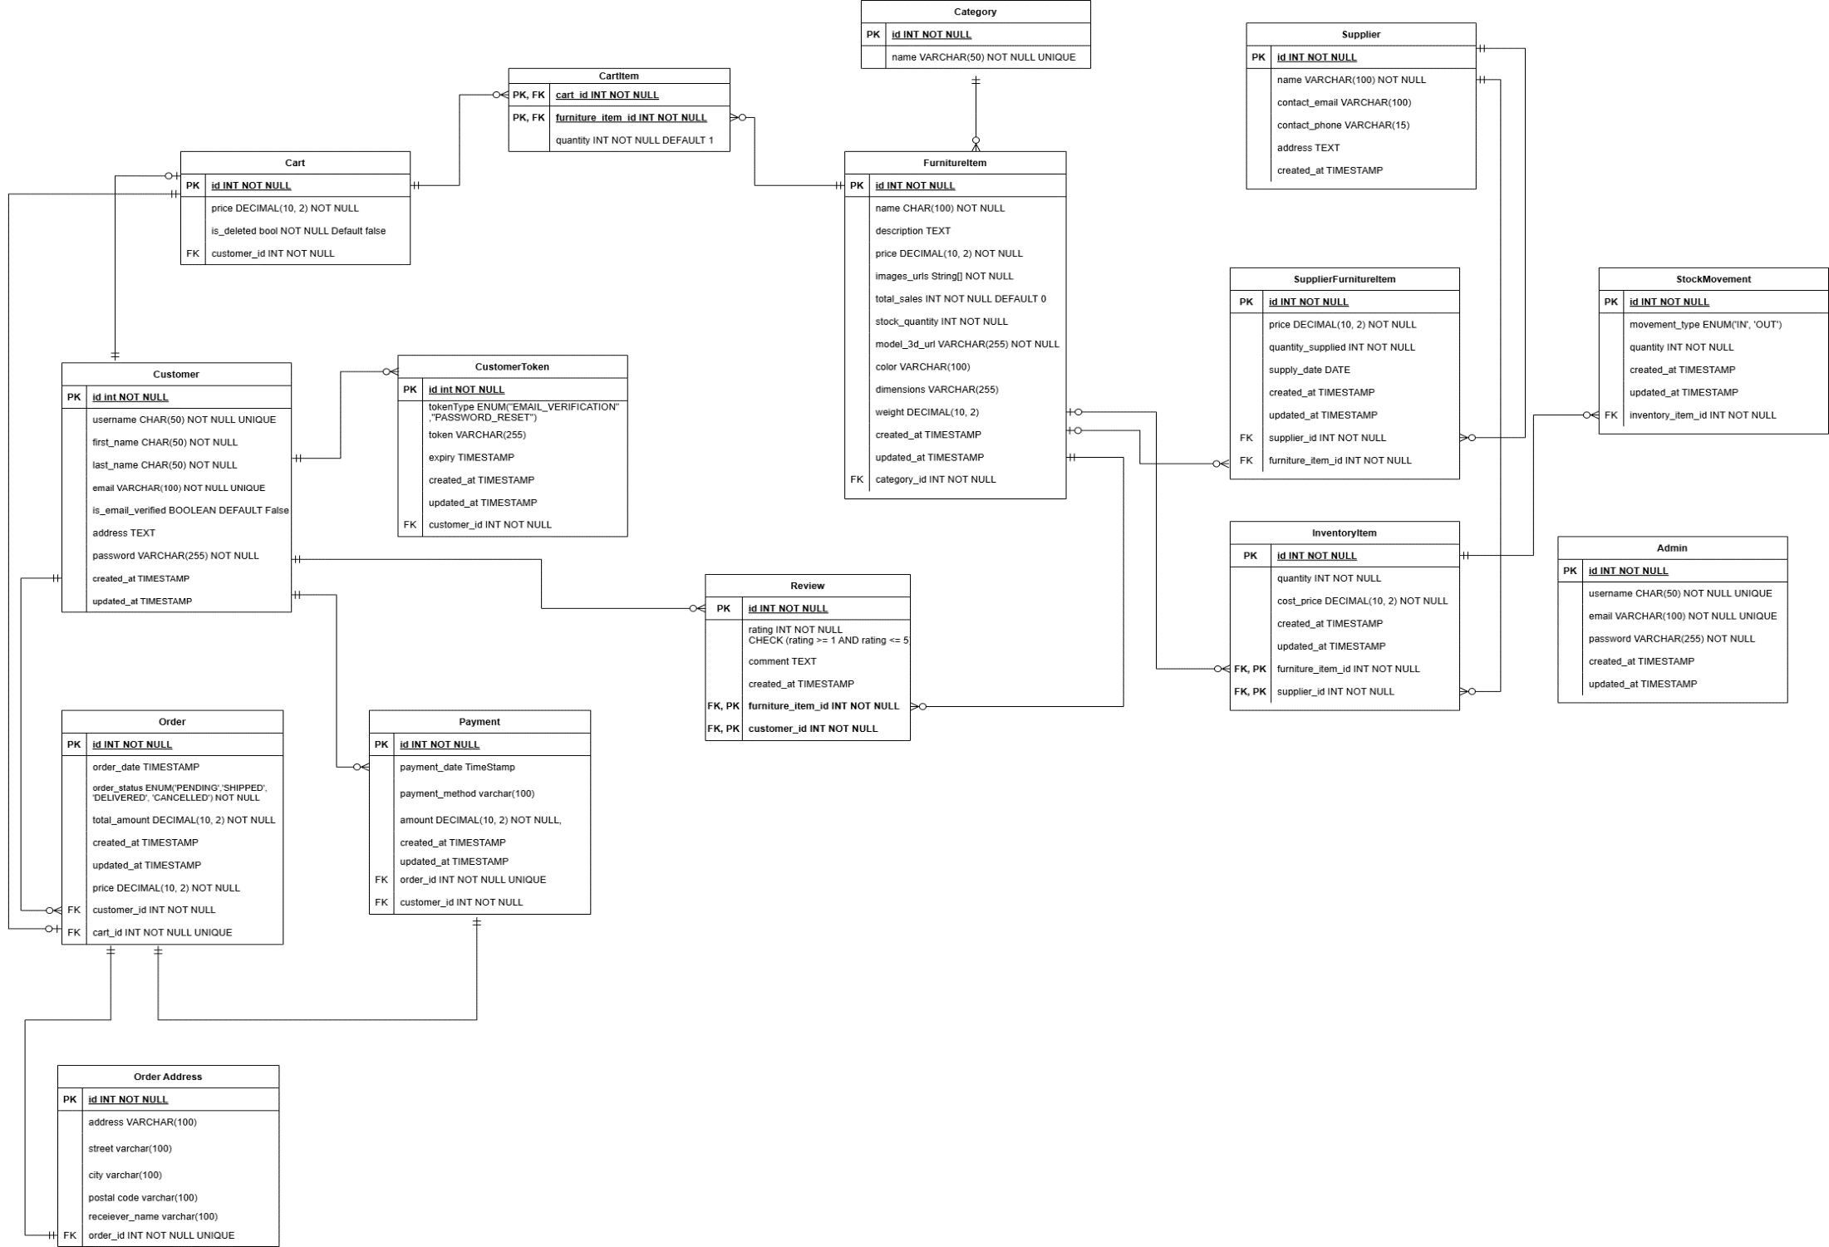
ER Diagram

Slide 17
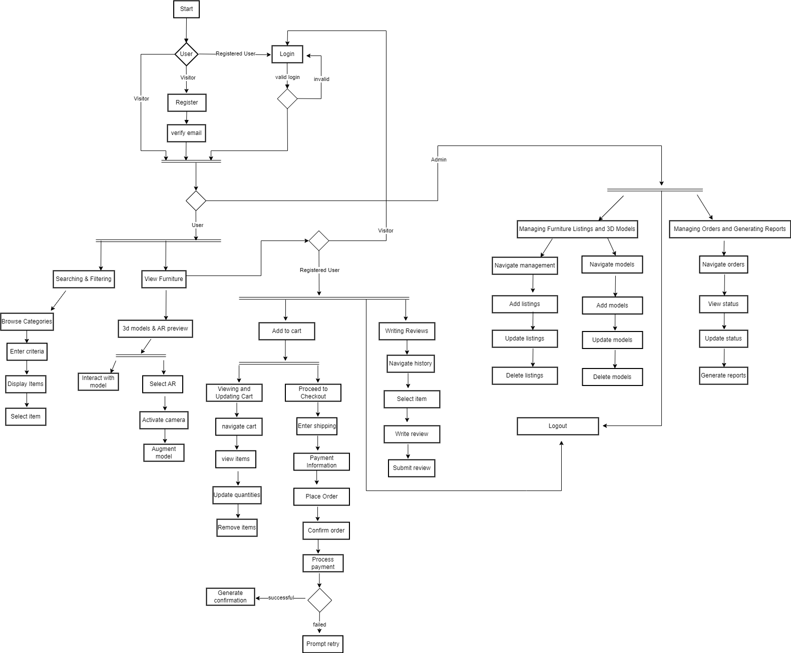
Activity Diagram

Slide 18
Details of 1st Iteration (30%)
Furniture Explorer (Listing, Searching and Pagination).
User Registration and Authentication.
Made some 3D models of Furniture Items in Blender.
Augmented Furniture Item on Ground Plane.

Slide 19
Details of 2nd Iteration (60%)
Enhanced Cart and Checkout System.
View 3D model on website.
Implement backend functionality for dynamic loading of 3D models.
Enable real-time augmentation of furniture models using scripting.
Design 3D models of other categories Furniture Items.

Slide 20
Details of 3rd Iteration (100%)
Complete Admin Panel.
Designed Advanced 3D furniture models of other categories.
Adjusted previous models measurement.
Improved accuracy of AR.
Enable real-time augmentation of furniture models using scripting.

Slide 21
Conclusion
In conclusion, the proposed AR-based furniture store project utilizes augmented reality technology to enhance online furniture shopping. Users can visualize furniture in their living spaces before purchasing, improving decision-making. Through comprehensive exploration of AR, 3D modeling, and e-commerce integration, the project aims to deliver a user-centric platform. With seamless integration and immersive experiences, it has the potential to redefine online furniture shopping.

Slide 22
Thanks

